Slide 1






Curriculum & Syllabus
for OBE/iCGPA
March 2017

Slide 2

Application of Malaysian Qualifications Framework (MQF)
Impact on Quality Assurance
Impact on QA Documents
Learning Outcomes
Teaching and Learning
Credit System

Slide 3

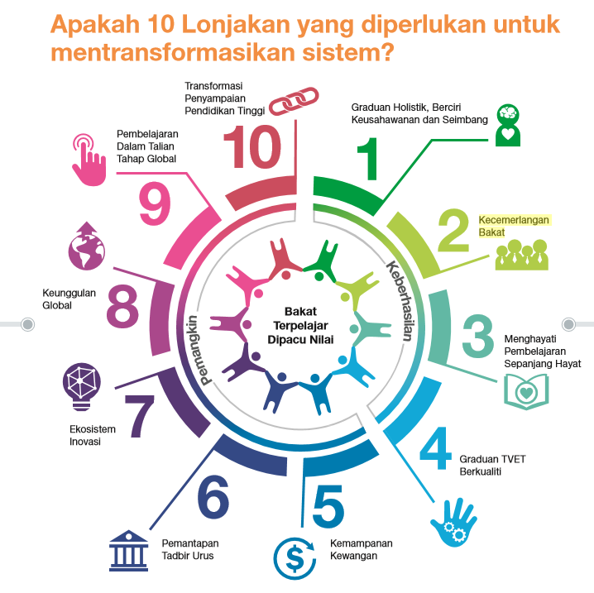


Issues and Challenges

Slide 4
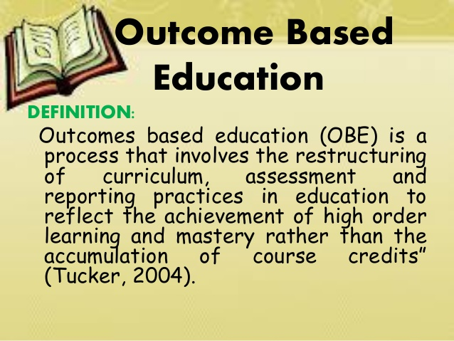

Slide 5
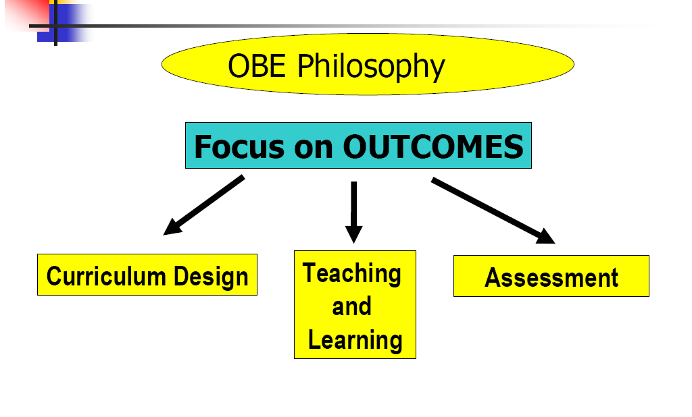
(R.E. Gerber, 1996 in Shahrin Mohamed, 2007 )

Slide 6
CONSTRUCTIVE ALIGNMENT
Regulatory / Professional Bodies
Quality Assurance JPT
IHL requirements
Industries
Stakeholders
students…
….. etc
Programe Educational Objectives
PEO-1
PEO-2
PEO-3
PEO-4
PEO-5
Programme Learning Outcomes
PLO-1
PLO-2
PLO-3
PLO-4
PLO-5
….. etc
Course
Learning Outcomes
CLO-1
CLO-2
CLO-3
CLO-4
CLO-5

Slide 7
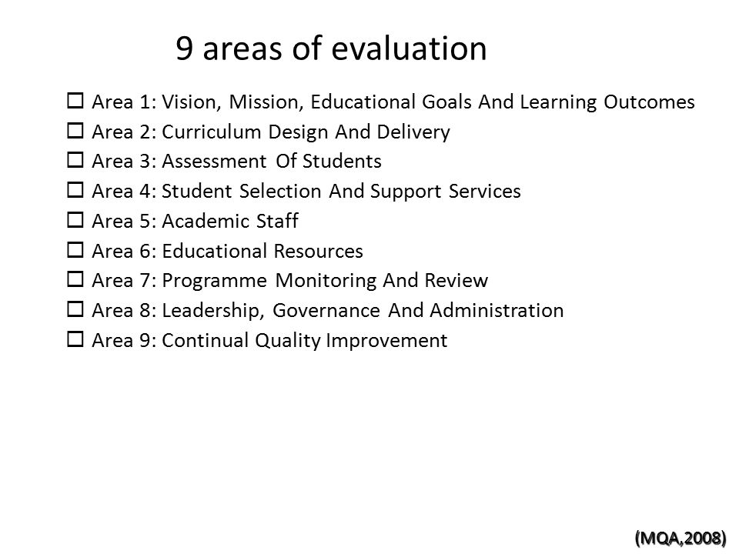

(COPPA)

Slide 8
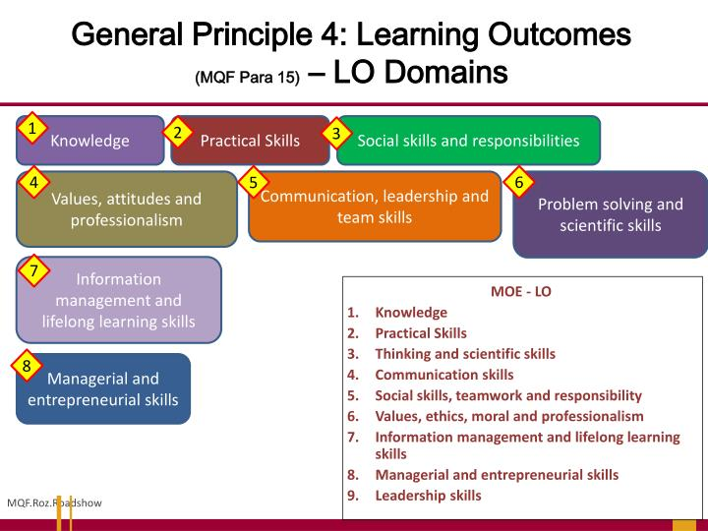
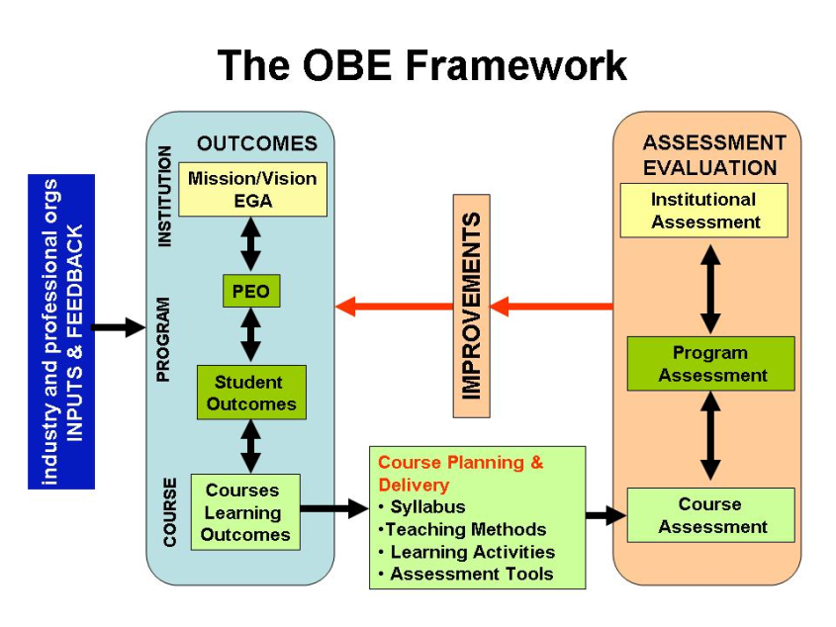
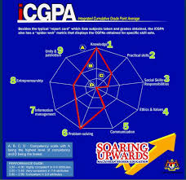

Slide 9
Program Design

Slide 10
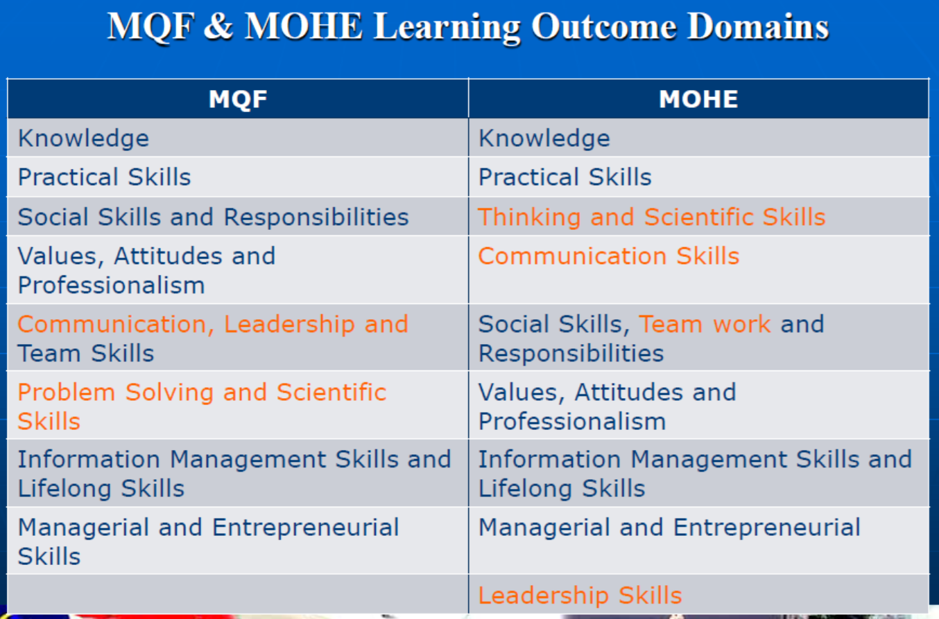

Slide 11
Example Bachelor of Science (IT)
Programme Learning Outcomes (PLOs) | Malaysia Qualification Framework (MQF)
Demonstrate knowledge and understanding of essential facts, concepts, principles and theories relating to information technology. (PLO1) | MQF1 Domain: Knowledge
Design, implement, utilize and manage information technology solutions and resources. (PLO2) | MQF2 Domain: Psychomotor/Practical/Technical Skills
Utilize relevant techniques, and demonstrate analytical and critical thinking skills in problem solving. (PLO3) | MQF6 Domain: Problem Solving and Scientific Skills
Communicate and work effectively with peers, clients, superiors and society. (PLO4) | MQF5 Domain: Communication, Leadership and Team working Skills)
Demonstrate skills in meeting people, talking with and accepting guidance and responsibilities. (PLO5) | MQF3 Domain: Social Skills and Responsibilities
Apply information management skills and principles of lifelong learning in academic and career development. (PLO6) | MQF7 Domain: Information Management Skills and Lifelong Learning
Apply broad business and real world perspectives in planning effectively, making judgments and demonstrating entrepreneurial skills. (PLO7) | MQF8 Domain: Managerial and Entrepreneurial Skills
Demonstrate professionalism, values, attitudes and ethical considerations in accordance with ethical and legal principles. (PLO8) | MQF4 Domain: Values, Attitude and Professionalism
Demonstrate the ability to influence others in completing a common task. (PLO9) | MQF5 Domain: Communication, Leadership and Team working Skills

Slide 12
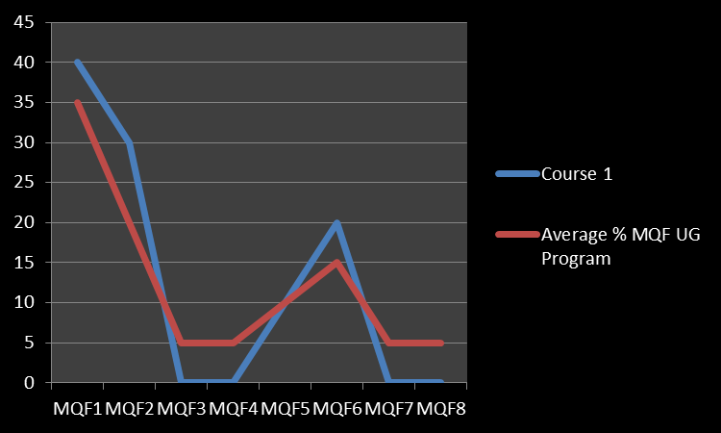

Slide 13
Check List
University Mission and Vision – Management University
Understand Program Educational Objectives (PEO
/Program Aims)
Understand Program Learning Outcomes (PLO)
Understand MQF to support PLO (MQF1 – MQF8)
Program Strength (Percentage outcome for every MQF)
Understand CLO to support PLO
Understand Assessment by PLO, MQF and CLO
List of Service Learning (SL) Courses in Program
List Student Centered Learning (SCL) Courses in Program
Blended Learning Courses in Program

Slide 14
Syllabus Design

Slide 15
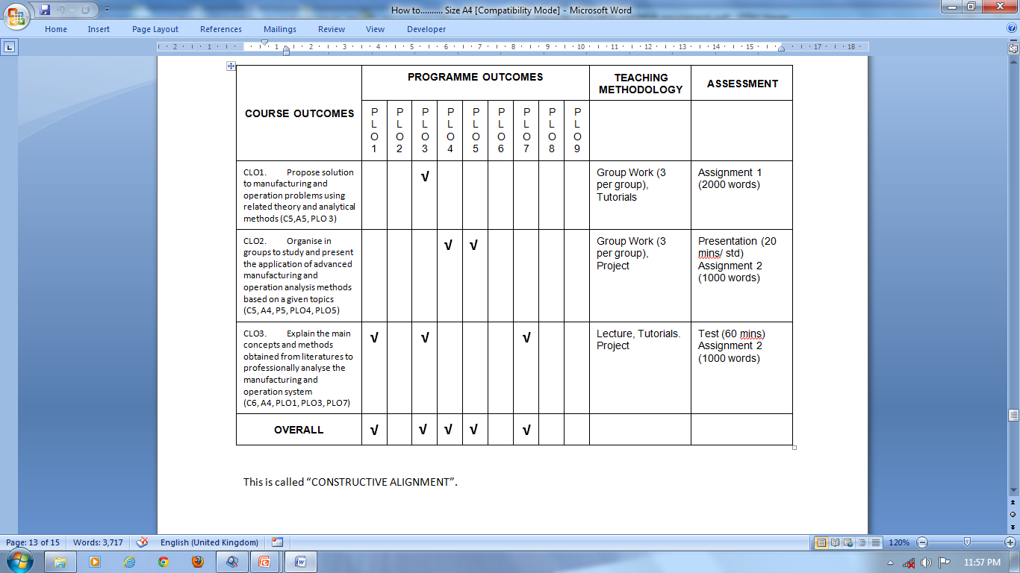
Mapping CLO to teaching methods and to assessment methods

Slide 16
NOT BLENDED LEARNING
3 CREDITS – BKAR1013
Blended 100:0 |  |  |  |  |  | Coursework 50:50
COURSE DELIVERY METHOD |  |  |  |  | SELF LEARNING |  |  |  | Total
F2F |  |  |  | Online Teaching | Class Prep | Coursework | Exam Prep | Exam
100% of 42hrs |  |  |  | 00% of 42hrs |  | 50% of 36hrs | 50% of 36 hrs
TL | T | P | SCL/O | OL
28 | 14 | 0 | 0 | 0
42 |  |  |  | 0
42 |  |  |  |  | 42 | 18 | 15 | 3
84 |  |  |  |  |  | 36 |  |  | 120

Slide 17
BLENDED LEARNING COURSE

Slide 20
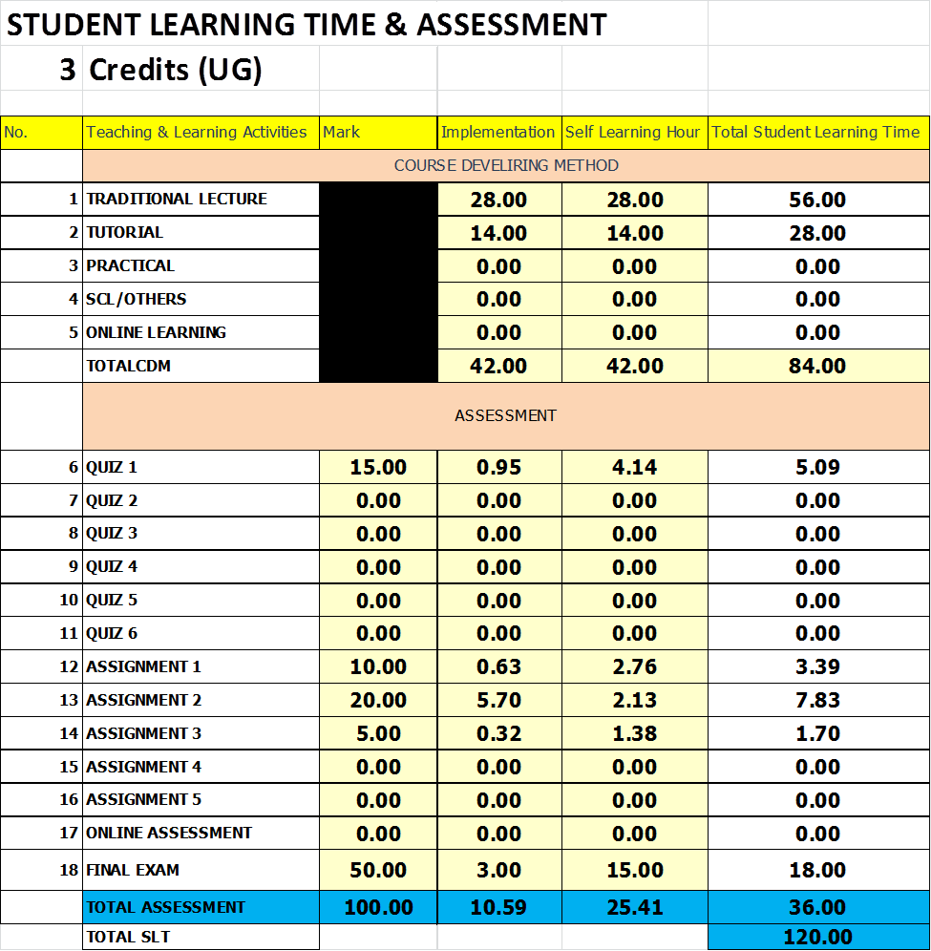

Slide 23
Check List
Student Learning Time (SLT)
Course Delivery Method (CDM)
CDM Blended Learning
Course Learning Outcome (CLO)
Mapping CLO PLO/MQF
Scheme of Works (SOW)
Bloom Tax Level and Rubric (2 Knowledge/Practical
and 6 soft skills)
Assessments and Rubrics
Marks (for lecturers) by CLOs

Slide 24
Assessment

Slide 25
UUM Assessment – Syllabus Development
Type | Assessment Plan
Test | Mark/Not Standardize Rubric
Problem Solving | Mark/Not Standardize Rubric
Product | Mark/Not Standardize Rubric
Presentation | Mark/Not Standardize Rubric
Writing | Mark/Not Standardize Rubric
iCGPA Assessment
Malaysia Qualification Framework (MQF) | Assessment Plan
Knowledge (MQF1) | Mark
Practical Skills (MQF2) | Mark
Social Skills and Responsible (MQF3) | iCGPA Rubric
Values, Attitudes and Professionalism (MQF4) | iCGPA Rubric
Communication, Leadership and Team Skills (MQF5) | iCGPA Rubric
Problem Solving and Scientific Skills (MQF6) | iCGPA Rubric
Information Management Skills and Lifelong Skills (MQF7) | iCGPA Rubric
Managerial and Entrepreneur Skills (MQF8) | iCGPA Rubric
iCGPA/ACCSB
Assessments & Rubrics
?

Slide 26
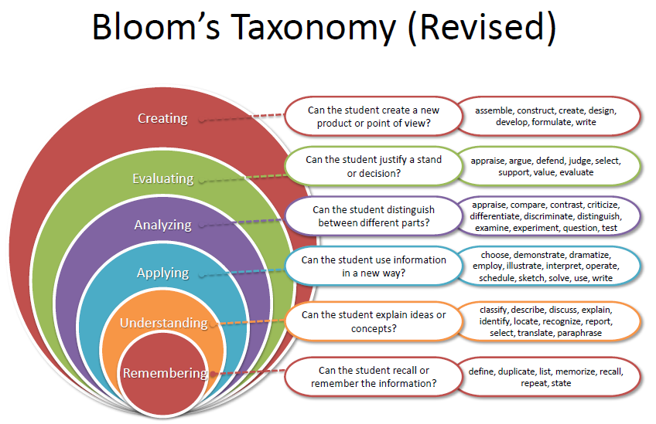
iCGPA MQF 1 & 2 – Knowledge & Practical Skills

Slide 27
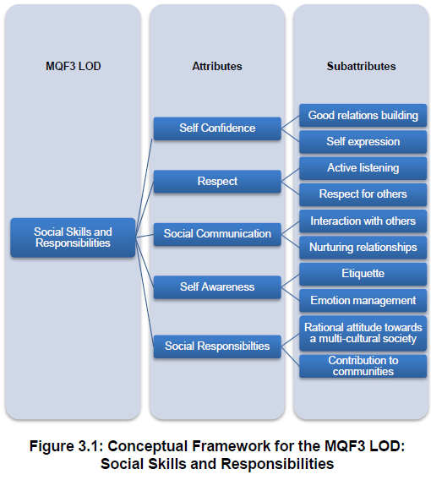
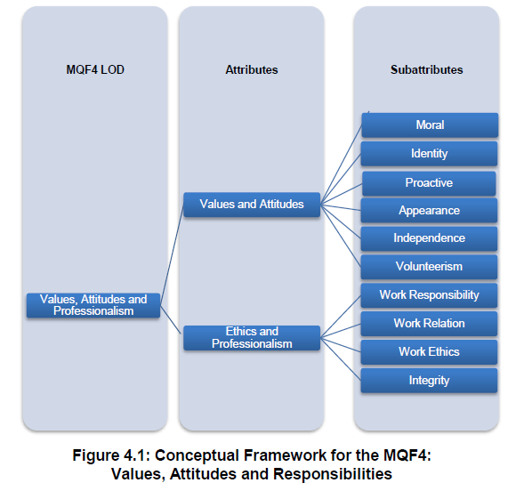
iCGPA MQF - Rubrics

Slide 28
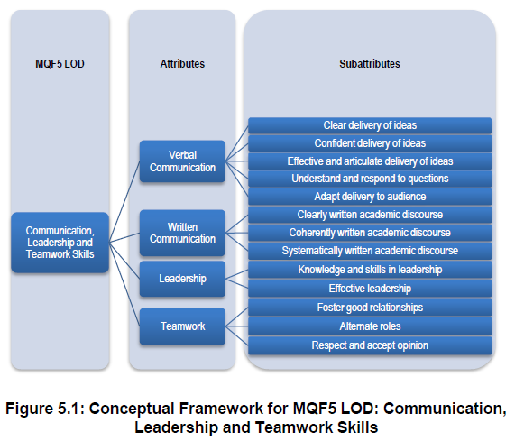
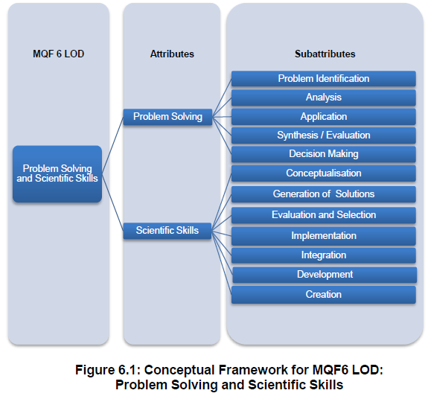
iCGPA MQF - Rubrics

Slide 29
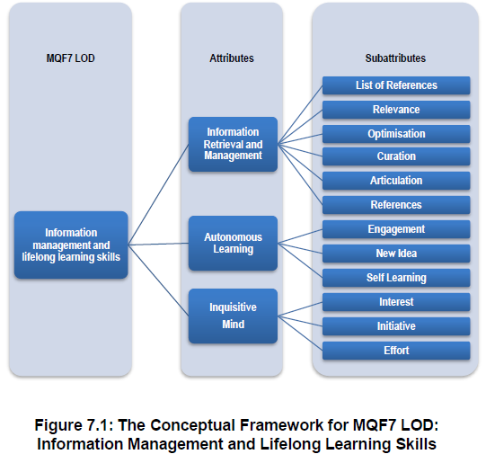
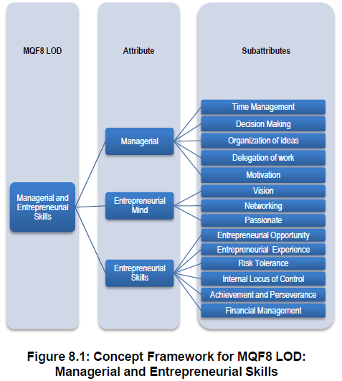
iCGPA MQF - Rubrics

Slide 30
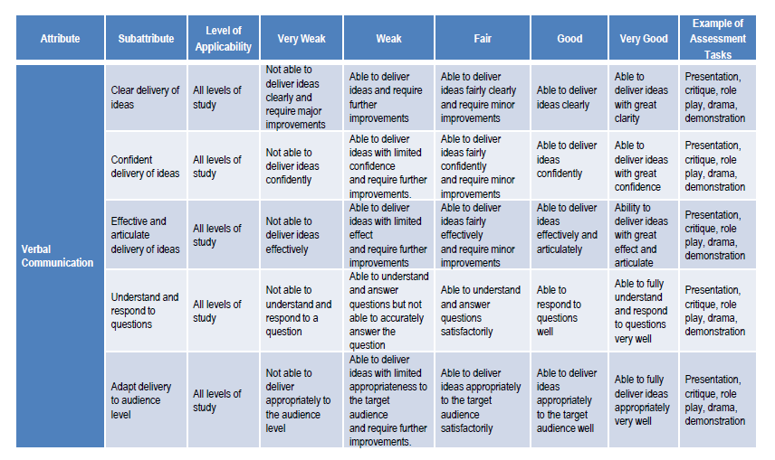
iCGPA MQF – Example Rubrics
Verbal Communication

Slide 31
AACSB Rubric

Slide 32
AACSB Rubric

Slide 33
iCGPA - Pilot

Slide 34
BKAR1013 : MAPPING CLOs - PLOs
Programme Learning Outcomes (Bachelor Of Accounting) | Malaysia Qualifications Framework (MQF) | Course Learning Outcomes
 |  | 1 | 2 | 3 | 4 | 5
Prepare, apply, interpret, and evaluate financial and non-financial information in accordance with approved accounting standards to assist them in making business and organizational decisions. (PLO1) | Knowledge (MQF1) | ✓ | ✓ | ✓ | ✓ | ✓
Acquire accounting and non-accounting information and apply them in performing financial, audit and taxation functions. (PLO2)
Apply information technologies and systems for the attainment of organisational objectives. (PLO3)
Demonstrate ability in (a) problem diagnosis, and (b) application of current knowledge or theories in solving problems in the dynamic global business environment. (PLO4) | Problem Solving and Scientific Skills (MQF6) | ✓ | ✓ | ✓ | ✓
Communicate effectively, both orally and in writing, with interested parties. (PLO5) | Communication, Leadership and Team Skills (MQF5) |  |  |  | ✓
Demonstrate appropriate interpersonal skills and teamwork. (PLO6)
Demonstrate awareness of ethics in the execution of their accountability. (PLO7)
Demonstrate commitments to life-long learning and professional development. (PLO8)
Demonstrate leadership qualities. (PLO9)
Demonstrate entrepreneurial skills. (PLO10)

Slide 35
COURSE ASSESSMENT PLAN
100%
Coursework
Assignments - 5%
Exam
Final Examination: 50%
Mid exam – 15%,
Mini Case – 10%
Comprehensive case -20%

Slide 36
PLO – CLO - ASSESSMENT MAPPING PLAN
 | CLO1 | CLO2 | CLO3 | CLO4 | CLO5 | TOTAL MARKS
PLO1: KNOWLEDGE (80%) Assessment tools & marks: Mini case Mid exam Assignment Final exam | 1 5 | 1 4 | 1 1 | 7 5 50 | 5 | 10 15 5 50
PLO4: CRITICAL THINKING (16%) Assessment tools & marks: Comprehensive case (CC) (Problem Solving - Rubric) | 1 | 1 | 1 | 13 |  | 16
PLO5: COMMUNICATION (4%) Assessment tools & marks: Comprehensive case (CC) (Presentation – Verbal Communication Rubric) |  |  |  | 4 |  | 4
Total | 7 | 6 | 3 | 79 | 5 | 100

Slide 37
ASSESSMENT TYPE - PLOS
PLO 1 | PLO 2 | PLO 3 | PLO 4 | PLO 5 | PLO 6 | PLO 7 | PLO 8 | PLO 9 | PLO 10
Assign 3 (Assignment)
Test CLO5
5%
Assign 1 (Mini Case)
Test CLO1,2,3,4
10%
Assign 2 (Comprehensive Case)
Prob. Solving CLO1,2,3,4 | Presentation CLO4
16% | 4%
Mid Sem & Final
Mid Sem (Test) CLO1,2,3,4 | Final (Test) CLO4
15% | 50%
Examination/Test | 80%
Problem Solving | 16%
Presentation | 4%

Slide 38
PLO - ASSESSMENT
PLO 1 | PLO 2 | PLO 3 | PLO 4 | PLO 5 | PLO 6 | PLO 7 | PLO 8 | PLO 9 | PLO 10
Assignment
5%
Mini Case
10%
Comprehensive Case
CTPS | Presentation
16% | 4%
Exam
Mid | Final
15% | 50%
PLO 1 | 80%
PLO 4 | 16%
PLO 5 | 4%

Slide 39
ASSESSMENT – MQF
MQF 1 | MQF 2 | MQF 3 | MQF 4 | MQF 5 | MQF 6 | MQF 7 | MQF 8
Assignment
5%
Mini Case
10%
Comprehensive Case
CTPS | Presentation
16% | 4%
Exam
Mid | Final
15% | 50%
MQF 1-Knowledge | 80%
MQF 5 – Verbal Communication | 4%
MQF 6 – Problem Solving | 16%

Slide 40
MQF – ASSESSMENT METHOD
MQF LOD | % | ASSESSMENT
MQF 1-Knowledge | 80% | Mark Scheme (0-100)
MQF 5 – Verbal Communication | 4% | Rubric AACSB (Scale1-4)
MQF 6 – Problem Solving | 16% | Rubric AACSB (Scale1-4)

Slide 41
RADAR WEB OUTPUT

Slide 43
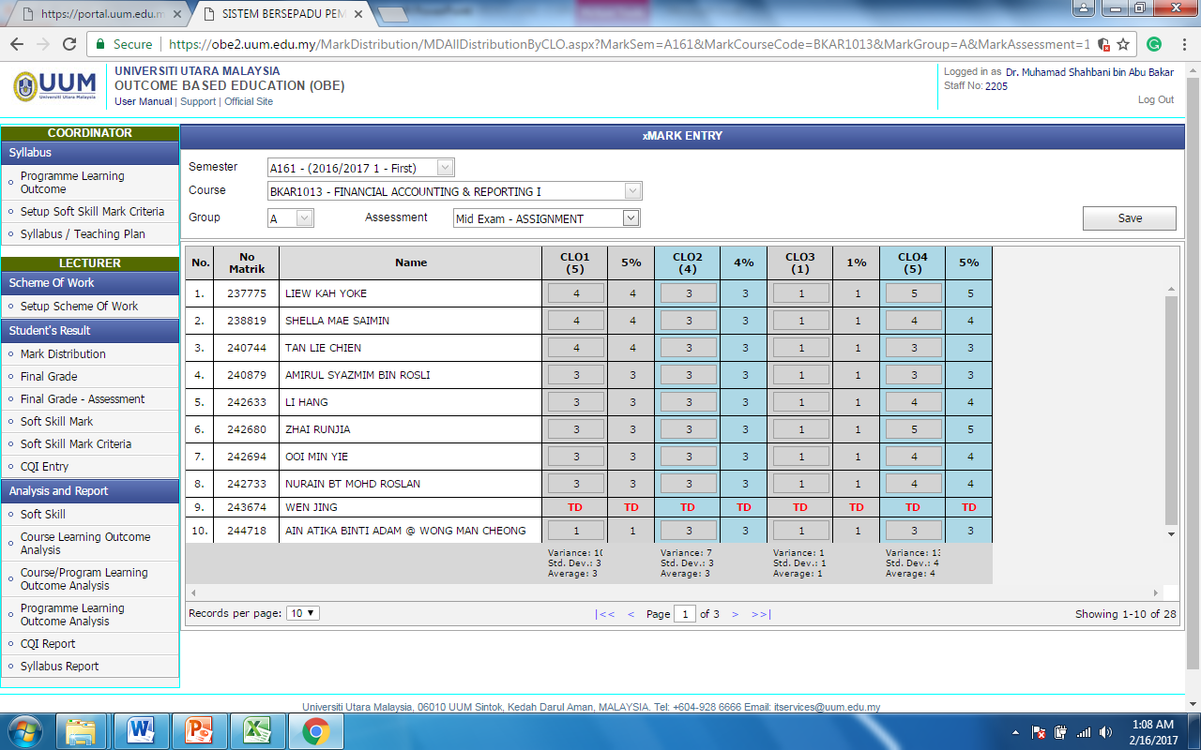

Slide 44
OBE PROCESS
Curriculum
PEO
Program
Standards
Curriculum REVIEW
Planning (1)
Academic Level
Program Outcomes (PO)
CQI Report
Closing the Loop (CDL)
Curriculum
Bloom’s
Taxonomy
Evaluating (4)
Developing (2)
Evaluate/ analyse
Course Outcomes (CO)
TL Activities
Assessments
Entrance/Exit Surveys
SLT
Bloom’s
Taxonomy
Test Blueprint
Implementing (3)
Lesson Plan
Credit Hour
Marking Scheme
Rubrics
Evidences
Curriculum
Student Portfolio
Formative Assessment
Bloom’s
Taxonomy
Documenting
Summative Assessment

Slide 45
Planning & Implementation
Strengthen the Syllabus (Coppa/MQA)
Upload to Repository
OBE Implementation (3 Phases)
Syllabus Standardization
iCGPA

Slide 46
OBE System

Slide 47
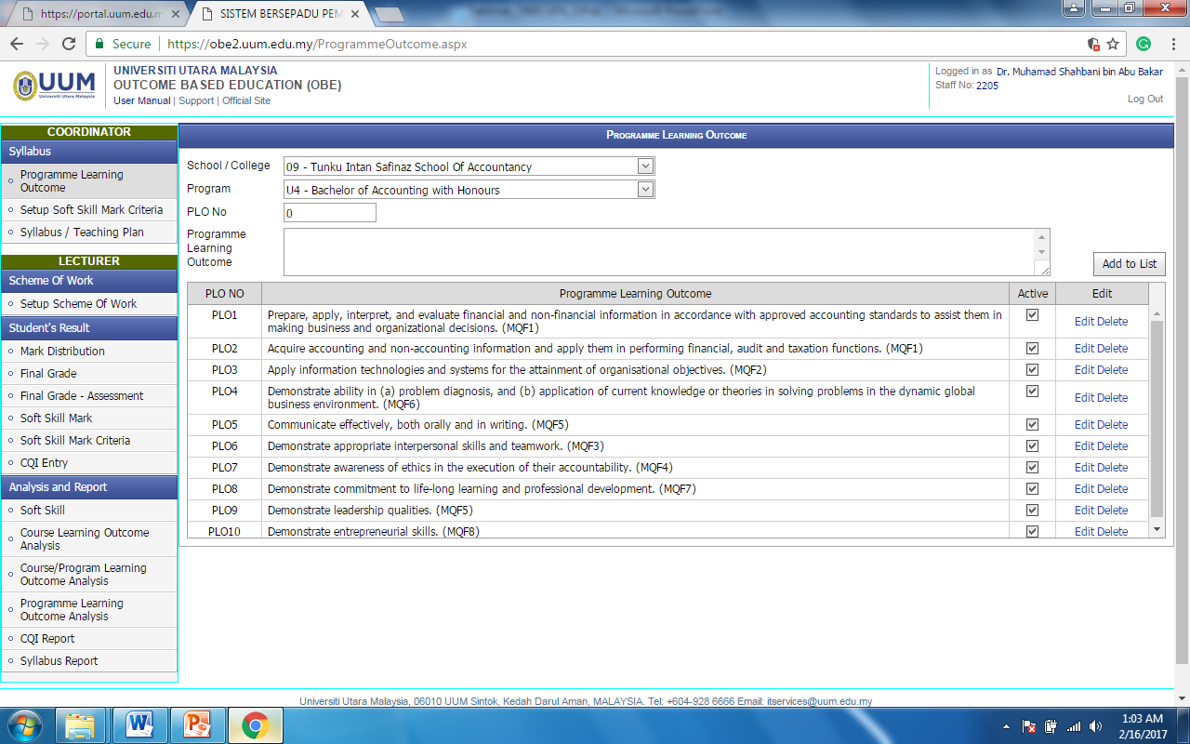

Slide 48
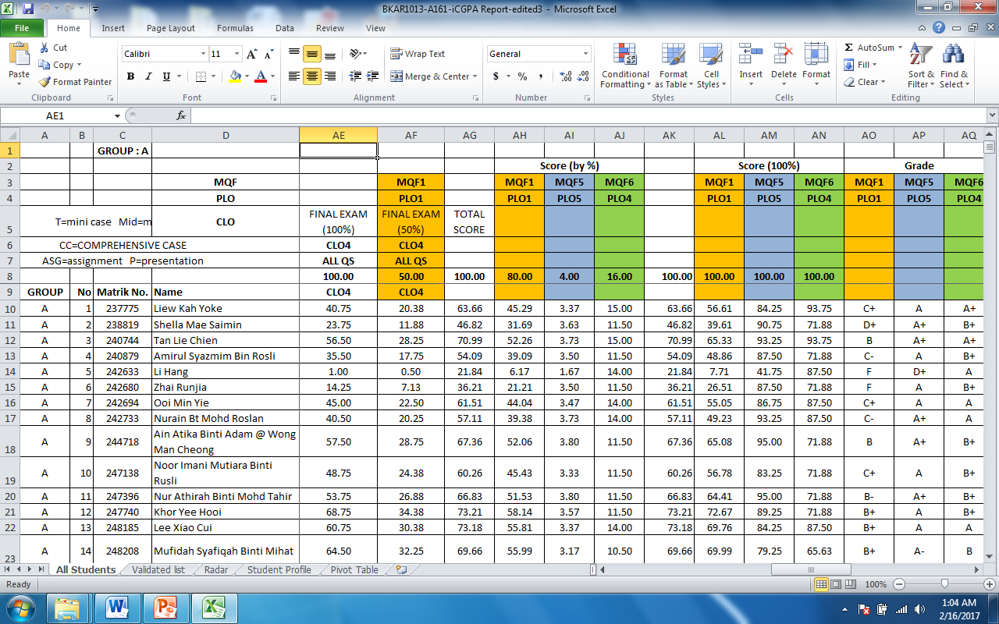
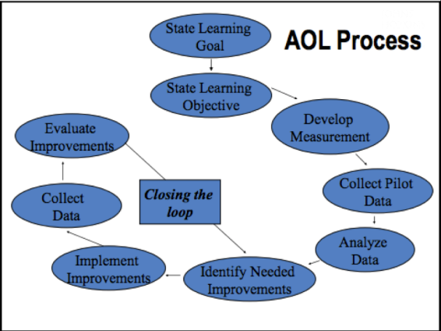
OR

Slide 49

Do it Right
School
Program Coordinators
Course Coordinators
Lectures

Slide 50
